Slide 1
Mini Project II
APIs – Pandas – SQL

Slide 2
Spend 1 min on project flow structure. Which steps does your project have?
Show results in 1-2 minutes.
Which of your APIs was your favorite and why? (1 min)
Explain the biggest challenges in 1 min.
what would you do if you have a bit more time?

Slide 3
Spend 1 min on project flow structure. Which steps does your project have?
Show results in 1-2 minutes.
Which of your APIs was your favorite and why? (1 min)
Explain the biggest challenges in 1 min.
what would you do if you have a bit more time?

Slide 4


Results
Coffee Houses | Calgary | Edmonton
Yelp | 42 | 13
Foursquare | 33 | 34

Slide 5
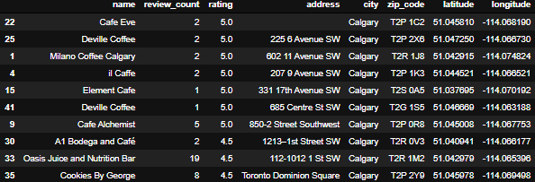
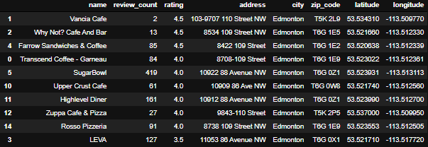
yelp

Slide 6
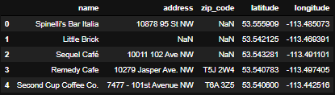
FS

Slide 7
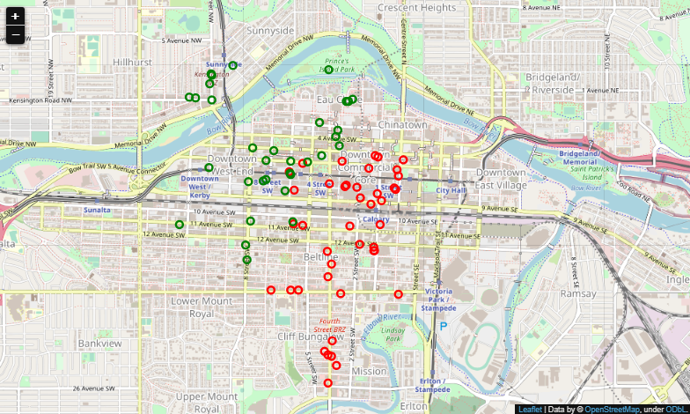

Slide 8
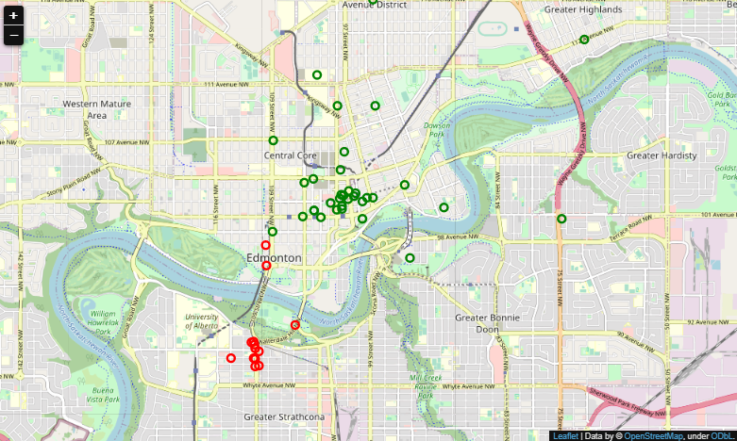

Slide 9
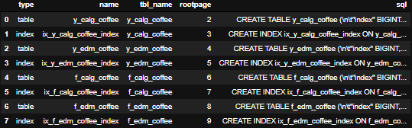

Slide 10
Spend 1 min on project flow structure. Which steps does your project have?
Show results in 1-2 minutes.
Which of your APIs was your favorite and why? (1 min)
Explain the biggest challenges in 1 min.
what would you do if you have a bit more time?

Slide 11
Spend 1 min on project flow structure. Which steps does your project have?
Show results in 1-2 minutes.
Which of your APIs was your favorite and why? (1 min)
Explain the biggest challenges in 1 min.
what would you do if you have a bit more time?

